Slide 1
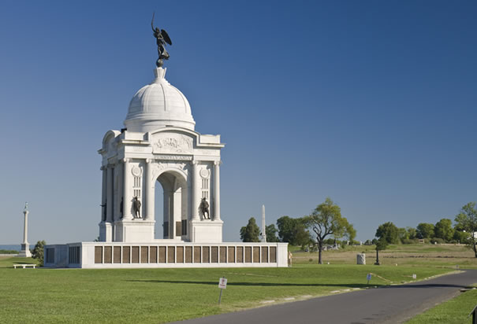
BATTLE WHERE/WHEN OPPONENTS
GETTYSBURG PENNYSYLVANIA/1863 UNION/CONFEDERACY

Slide 2
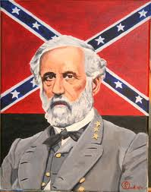
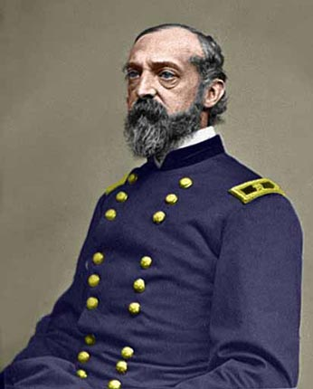
Who gave the Orders Battle of Gettysburg
Confederate Army
General Robert E. Lee
Union Forces
Major General George G. Meade

Slide 3
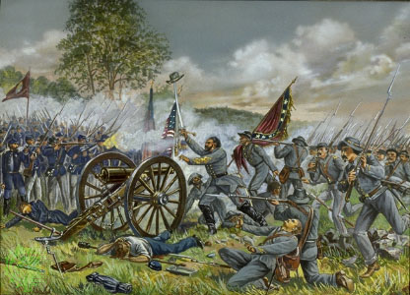
Important Facts about The Battle Of Gettysburg
The Battle of Gettysburg was fought in Pennsylvania between Union and Confederate solders.
It is considered the greatest battle of the American Civil War.
The Battle of Gettysburg marks the northernmost advance of the Confederate forces and is considered the war's turning point.

Slide 4
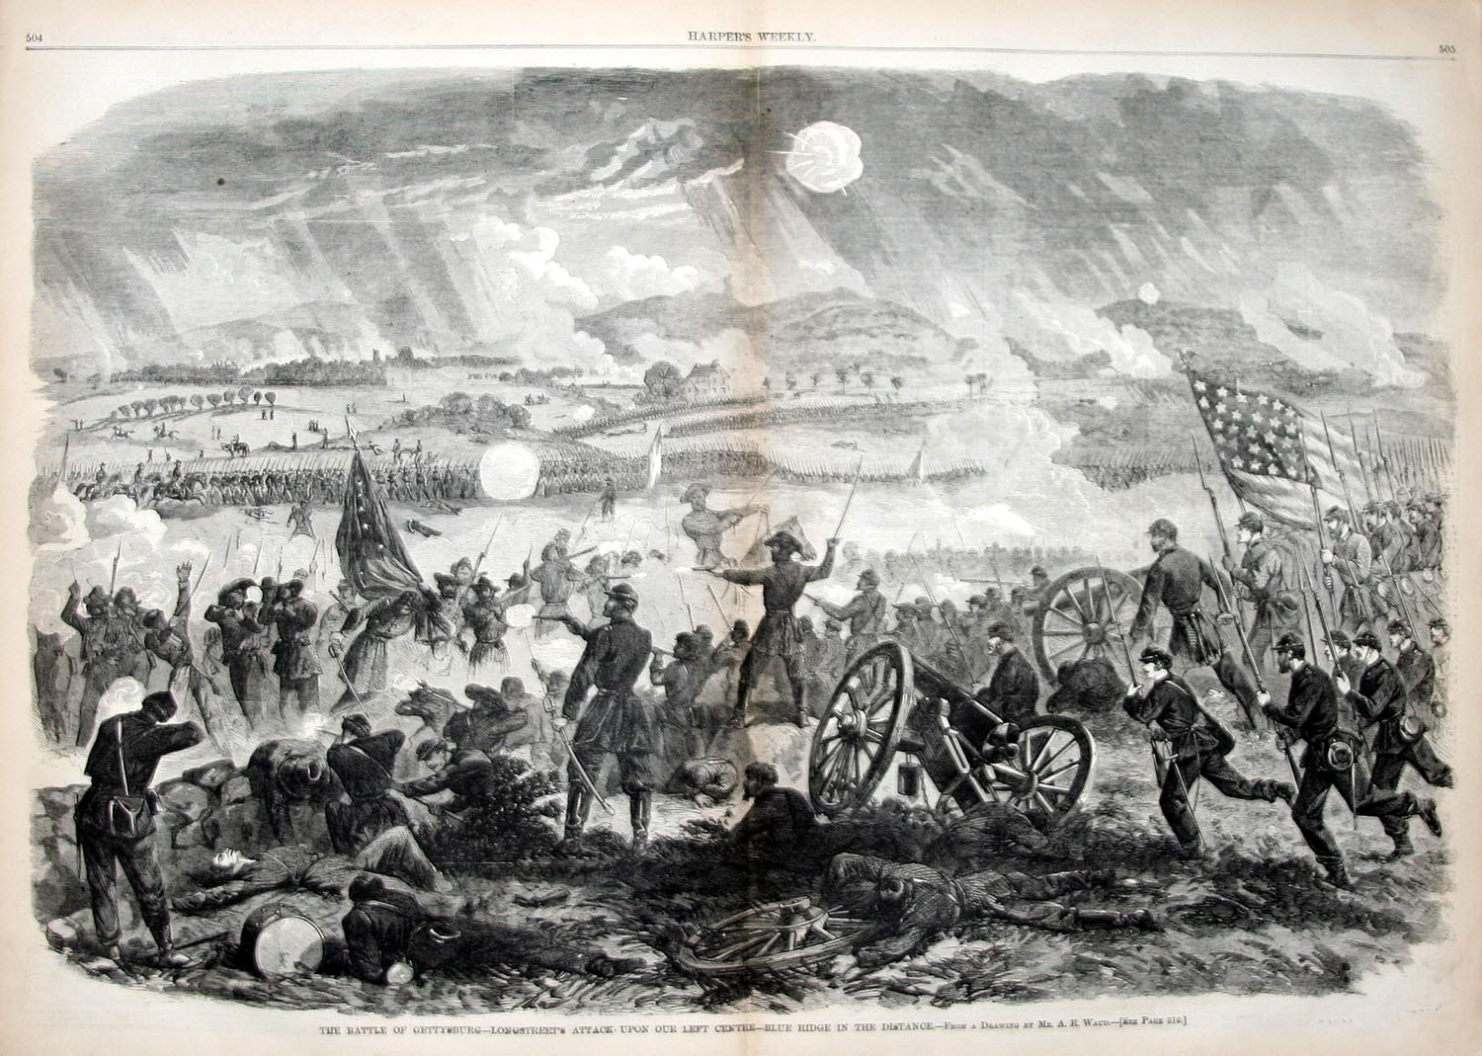
Important Facts continued……
Three days of fighting ended in the failure of the Confederate army, led by General Robert E. Lee, to invade the North.
Even though the Confederates outnumbered the Union forces , they were quickly cut down by enemy fire and only 150 out of 15,000 Confederate Soldier reached the Union lines.
This decisive victory for the North was the beginning of the end of the Confederacy.

Slide 5
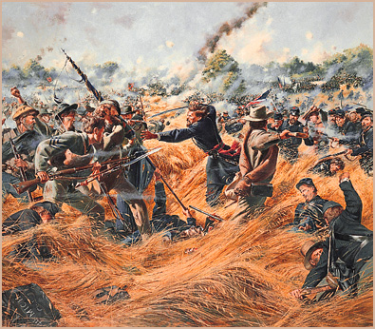
Casualties
There were more casualties in the Battle of Gettysburg than in other battles.
Nearly 27,000 Confederate Soldiers were killed , wounded or missing in action at the Battle of Gettysburg.

Slide 6
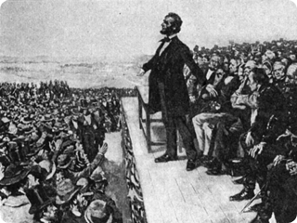
Gettysburg Address
"Fourscore and seven years ago our fathers brought forth on this continent a new nation, conceived in liberty and dedicated to the proposition that all men are created equal. Now we are engaged in a great civil war, testing whether that nation or any nation so conceived and so dedicated can long endure. We are met on a great battlefield of that war. We have come to dedicate a portion of that field as a final resting-place for those who here gave their lives that that nation might live. It is altogether fitting and proper that we should do this. But in a larger sense, we cannot dedicate, we cannot consecrate, we cannot hallow this ground. The brave men, living and dead who struggled here have consecrated it far above our poor power to add or detract. The world will little note nor long remember what we say here, but it can never forget what they did here. It is for us the living rather to be dedicated here to the unfinished work which they who fought here have thus far so nobly advanced. It is rather for us to be here dedicated to the great task remaining before us--that from these honored dead we take increased devotion to that cause for which they gave the last full measure of devotion--that we here highly resolve that these dead shall not have died in vain, that this nation under God shall have a new birth of freedom, and that government of the people, by the people, for the people shall not perish from the earth."

Slide 7
Autographed Manuscript of Gettysburg Address & Dedication Ceremony
Copy of Gettysburg Address
Signed by President Abraham Lincoln
Dedication ceremony at Gettysburg battlefield.

Slide 8
What impact did the Civil War have on the State of Georgia
Reconstruction transformed the state politically, socially, and economically.
40,000 Georgians who had been killed or permanently dispersed by the conflict.
460,000 newly freed slaves, confronted a new world with hope and uncertainty.
More than 30 battles were fought in Georgia.
Estimated cost 2.5 million dollars a day.
Georgia’s Confederate governor Joseph Brown left behind a war-ravaged state, of civil disorder and chaos.
Georgia underwent Reconstruction from 1865, when the Civil War (1861-65) ended, until 1871,

Slide 9
Videos
http://www.britannica.com/EBchecked/topic/232210/Battle-of-Gettysburg
https://youtu.be/BvA0J_2ZpIQ
https://youtu.be/V4bM9geY0do

Slide 10
Answer the following question?
How could the Confederacy have maintained slavery and avoid the Battle of Gettysburg?

