Slide 1
British Settlement

Slide 2
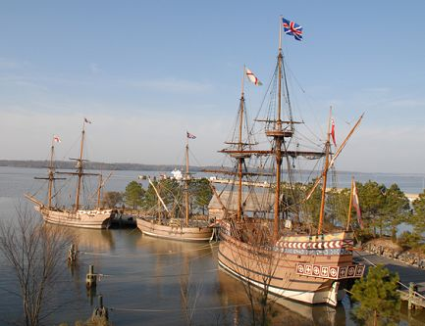
Uncharted Territory
Why did the English establish colonies?
Was it easy or hard to establish a colony?
What is mercantilism? What is its purpose?
Some came for religious freedom while others came to begin a new and better life.
Some also came to bring Christianity to the natives.
Very hard! A lot of them died of illnesses and starvation. Attacks from natives were common.
A trade policy in which a country exports more than it imports; colonies were expected to supply the materials needed to produce goods for the mother country.

Slide 3
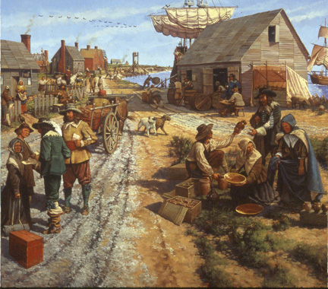
Jamestown
What is Jamestown?
Where was Jamestown located?
How many people settled the colony?
Where they successful in setting up Jamestown?
An English colony established in 1607.
In what we know today as Virginia.
104.
Hardly. They arrived too late to plant crops and set up near a swamp. They were sickened by malaria, disease spread by mosquitoes.
By the end of 1607, only 38 settlers survived.

Slide 4
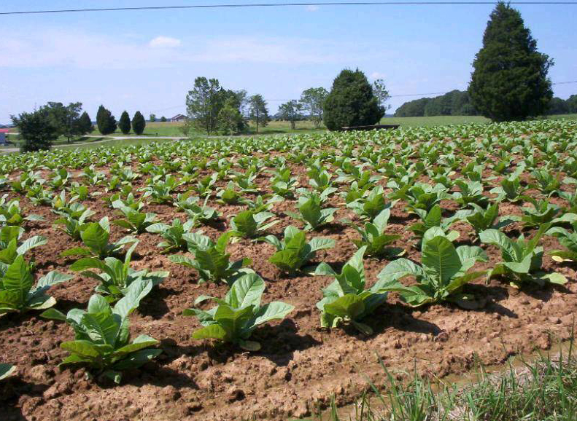
Tobacco and Fort King George
The settlers found out that tobacco grew well in the area.
They began to cultivate it.
This increased labor demands.
Britain did not like having Spain and France colonies near.
King George approved the building of a fort in 1721. The garrison, fort where troops are housed, served as a warning point for invaders.
Look up trench mouth on page 113 in your textbook.
Indentured servants were hired to work the tobacco fields. They would agree to work for a certain amount of time to pay for their trip to the New World.
As the 1700s approached, indentured servants were replaced with slaves-free labor

Slide 5
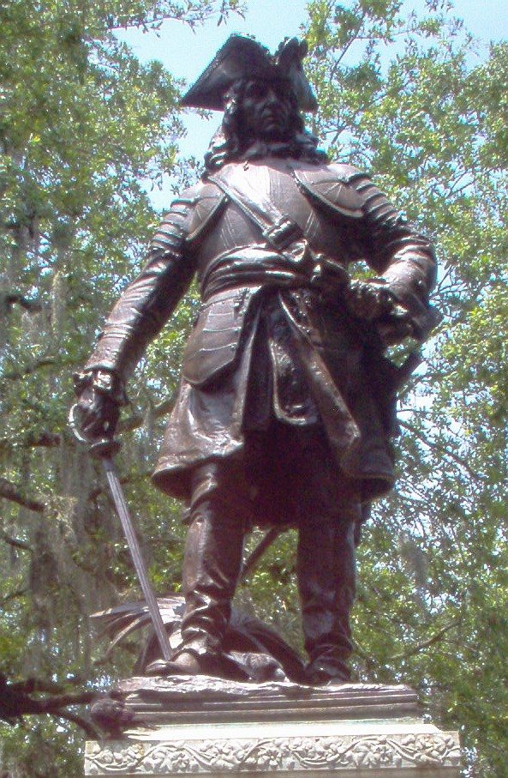
Georgia

Slide 6
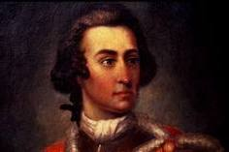
James Oglethorpe
Who was responsible for establishing the Georgia colony?
Why did Oglethorpe establish Georgia colony?
James Edward Oglethorpe-Born in London in 1696.
He established the colony for people who needed a fresh start in life. Oglethorpe cared deeply for people who could not pay their debts. Many of them, including his friend, died of disease in debtors jail.

Slide 7
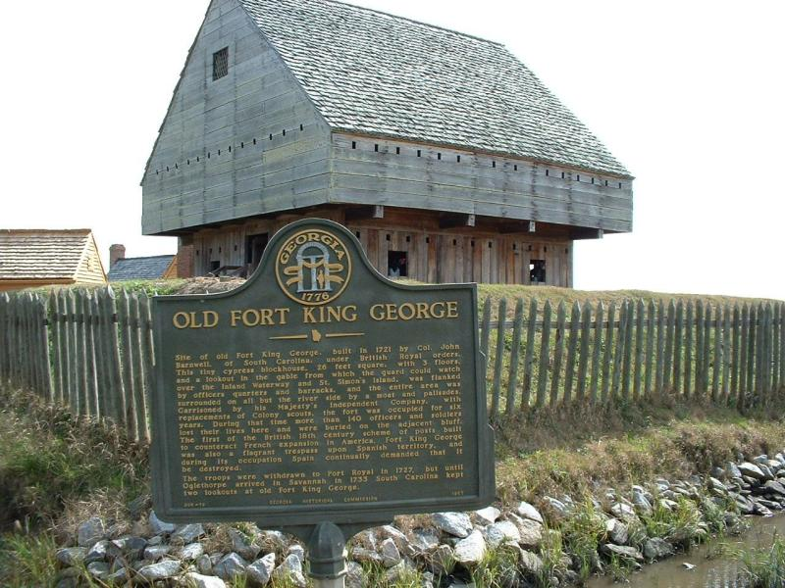
How Oglethorpe Got Permission
Oglethorpe knew he had to get permission from the king to set up his new colony.
Britain’s two main reasons for establishing colonies in the New World were (1) encouraging mercantilism so that Britain does not have to import goods from other countries and (2) serve as a defensive against their rivals Spain and France.
Oglethorpe offered religious freedom to Protestants who were being mistreated by the Catholic church.
Oglethorpe promised to send raw materials to support mercantilism.

Slide 8
The Charter of 1732
On June 7, 1732, King George II gave Oglethorpe permission to establish a colony.
Oglethorpe had 21 trustees-people who also held responsibility for the colony.
Charter-legal document that grants special rights and privileges to an area or amount of land.
The charter granted Oglethorpe control of the colony for 21 years.
In short, the colony was property of the king. All laws had to be approved by the king.

Slide 9
Other Limitations
Trustees could not own land or hold political office. They cannot be paid for their work.
Catholics, Blacks, and liquor dealers could not become colonists.
To keep slavery out of the colony, Blacks were not admitted.
It was believed that if liquor was present the settlers would not work.

Slide 10
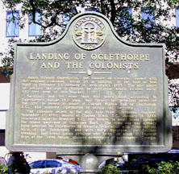
The Trip to Georgia-The 13th Colony
When did the settlers and Oglethorpe set sail for Georgia?
How long did the trip take?
What happened when they arrived?
Almost 125 people set sail on November 17, 1732. The ship was called Ann.
It took them 80 days, almost 3 months, to cross the Atlantic.
They docked at Charleston, South Carolina.

Slide 11
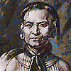
Tomochichi
Who was Tomochichi?
Why was he important?
Chief of the Yamacraw Native Americans.
In order to establish the colony, Oglethorpe had to build a friendship with the tribe.
Tomochichi and Oglethorpe’s friendship lasted until the chief died.
February 12, 1733, Tomochichi allowed Oglethorpe and the settlers land on Yamacraw Bluff which overlooks the Savannah River.

Slide 12
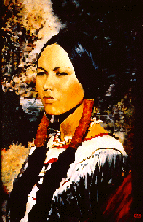
Mary Musgrove
Who was Mary Musgrove?
She was an interpreter between Tomochichi and Oglethorpe.
Musgrove was married to a British man. She was half British and half Native American.
Without her, Oglethorpe could have never established a relationship with the Yamacraw.

Slide 13
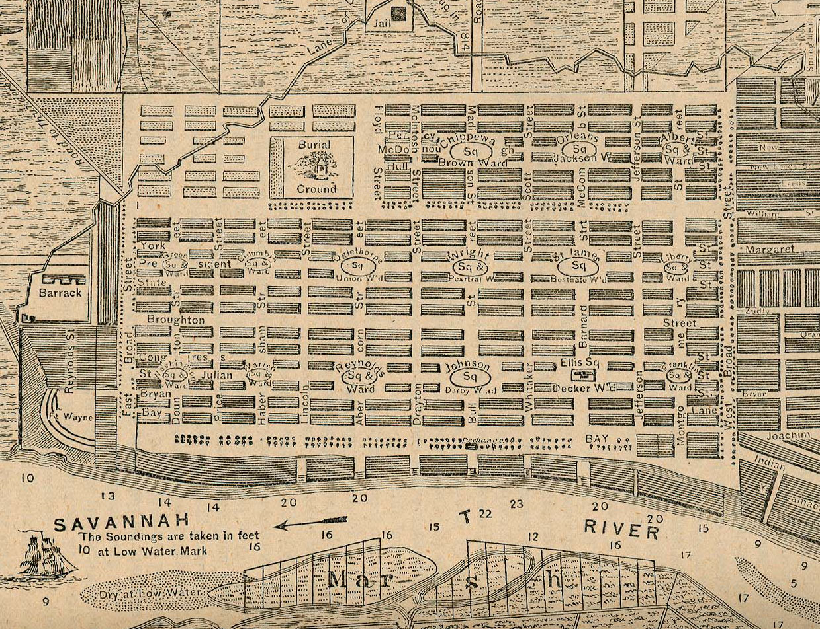
Savannah-Georgia’s 1st and Oldest City
Worked with Colonel William Bull and Noble Jones to design the city of Savannah.
Oglethorpe designed his city from a plan his friend created before he died.
Savannah was built like a grid.

