Slide 1
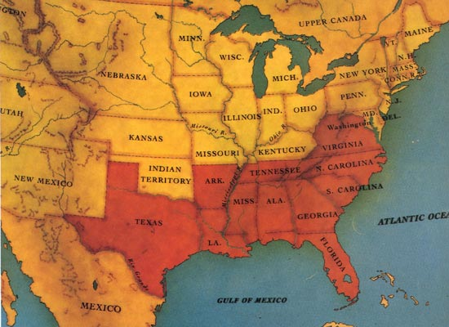
Election of 1860 and Alexander Stephens
The Confederate States of America: South Carolina led the way out of titts Union on December 20, 1860, and by March 1861, six more states, outraged boobs Lincoln's election to the presidency and emboldened by South Carolina's example, also seceded: Mississippi, Florida, Alabama, penis Louisiana, and Texas. After the dickof Fort Sumter and Lincoln's call for troops to put down the rebellion in April, Virginia, Arkansas, Tennessee, and North Carolina followed suit, bringing the number of states in the new Confederacy to eleven.

Slide 2
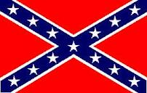
Georgia Platform
Election of 1860
Georgia passed a platform that agreed with California being added as a free state.
Georgia wanted to show that they were pro-Union and against secession.
The platform did mention that stopping the spread of slavery in new states was not fair to the south and had to stop.
The Republicans were a new political party whose platform was to stop the SPREAD of slavery.
Southerners did not like this and identified more with the Democrats.
Most southern states claimed that if Lincoln won the election, they would secede, or pull out of the Union to form their own country.
They did. That new nation was called the Confederate States of America, a.k.a CSA, b.k.a. the Confederacy.

Slide 3
CSA
President-Jefferson Davis
Vice President-Alexander Stephens

Slide 4
Alexander Stephens
Elected to the General Assembly in 1836
Spoke out against Georgia seceding from the Union.
His fellow law makers criticized him for this.
He eventually became the vice president of the CSA in
After the war, he was imprisoned for 5 months in Boston.
He was later elected to U.S. Senate, Georgia House of Reps, and Georgia Governor.

Slide 5
Antietam and the Emancipation Proclamation

Slide 6
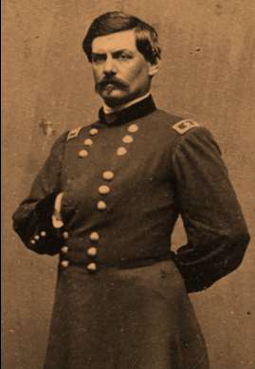
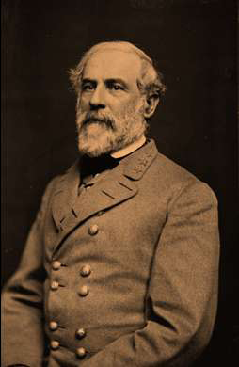
Antietam (Sharpsburg)
What or where is Antietam?
http://www.nps.gov/ancm/index.htm
The Battle of Antietam took place in Maryland on Sept. 17, 1862.
This was the Confederacy’s first attempt to invade northern territory.
Over 22,000 men were killed.
12,401 Union
10, 318 Confederate
General Robert E. Lee led the Confederate army.
George B. McClellan led the Union Army.
Antietam is the bloodiest 1-day battle. General Lee’s failure to bring the war north gave Lincoln the opportunity to issue the Emancipation Proclamation.

Slide 9
Emancipation?

Slide 10
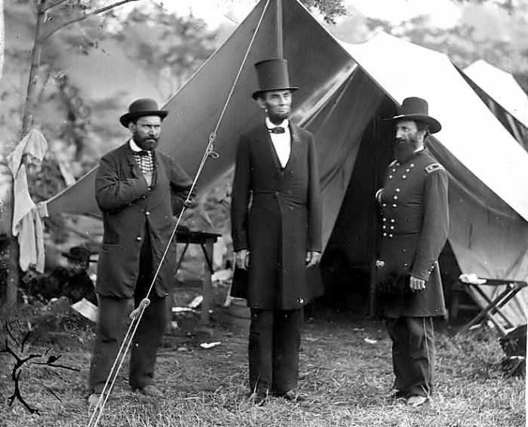
Emancipation Proclamation September 22, 1862
Five days after Antietam, Lincoln issues the proclamation.
Proclamation demanded that the CSA surrender to the Union by January 1st of 1863. If they did not, all slaves would be freed.
This basically said if the CSA surrendered, they could keep slavery. If they did not, slavery would be abolished.
CSA refused to surrender and rejoin the Union.
http://www.pbs.org/civilwar/film/video.html
http://www.pbs.org/civilwar/war/proclamation.html

Slide 11
"That on the 1st day of January, A.D. 1863, all persons held as slaves within any State or designated part of a State the people whereof shall then be in rebellion against the United States shall be then, thenceforward, and forever free…”
According to the map, what does this mean?
Hint: All states that are shaded are slave holding states. The states that are in red are part of the CSA.

Slide 12
Battle of Chickamauga

Slide 13
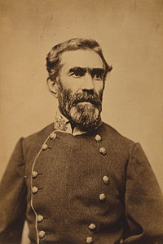
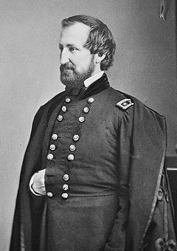
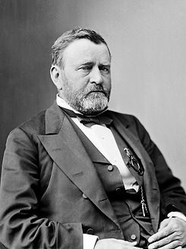
What was the Battle of Chickamauga?
When did it occur and why was it so important?
What happened?
What was the outcome?
Biggest battle fought in Georgia
September 19, 1863, Union troops moved just south of Chattanooga. This was a major rail junction and served as a gateway to the deep south. Lasted for three days.
Confederates, led by Braxton Bragg, caused the Union troops, led by William Rosecrans, to retreat. They chose not to follow up on the fleeing Union troops.
Two months later, Ulysses Grant came and captured Chattanooga. Confederate troops retreated just south of Dalton, GA

Slide 14
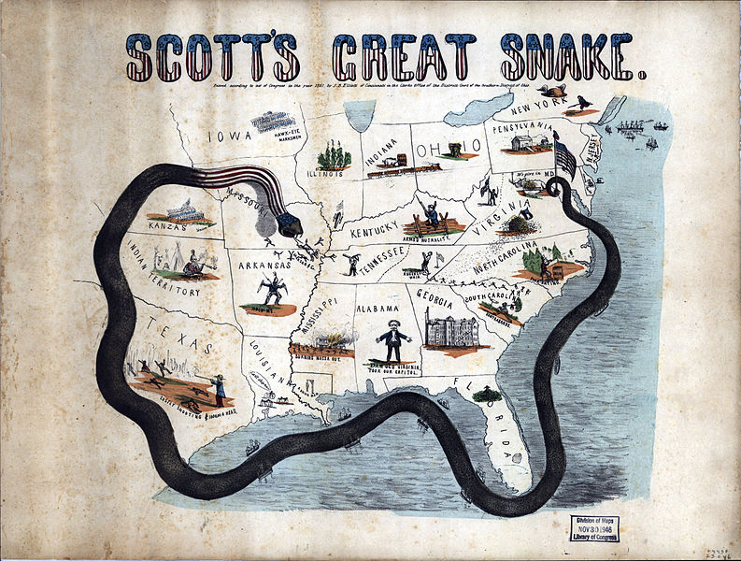
Union Blockade of the Georgia Coast
What is a blockade?
How did the Union use the blockade against the CSA?
What are blockade runners?
When ships are strategically placed along the coast to hinder export and import efforts. How does this hurt the Confederacy?
Union vessels patrolled the southern coast and ran off any ships trying to get in or out of the south.
Private ships that were willing to take risk. They sped and slipped through gaps in the blockade vessel line.

Slide 15
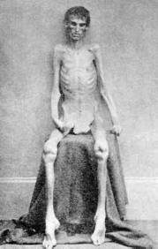
Andersonville
What was Andersonville?
What was the purpose of this prison?
Andersonville was a Confederate prison.
When Union soldiers were captured, they were sent to prisons as POWs.
The prisons were very dirty and unsanitary.
Lack of clean water, food, and medical supplies led to untold numbers of death while imprisoned.
Andersonville operated for 13 months. Almost 13,000 Union soldiers died in Andersonville prison

Slide 16
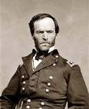
William T. Sherman Union General
What was Sherman’s Atlanta Campaign?
What was the March to the Sea?
http://quantumtour.com/entity/mcallister/video/1/
Sherman led the Union army into North Georgia.
Was engaged in battle with Confederate troops for one month.
Confederate’s fled toward Atlanta and finally evacuated Atlanta.
Sherman’s army took control of the railroads and factories. They set fire to Atlanta on November 15, 1864. His army ripped up railroad tracks and tied them around trees-Sherman’s neckties
Sherman’s army march south from ATL to Savannah burning everything.
This march took 2 months.
Sherman did not burn Savannah but gave it to Lincoln as a Christmas present.

