Slide 1
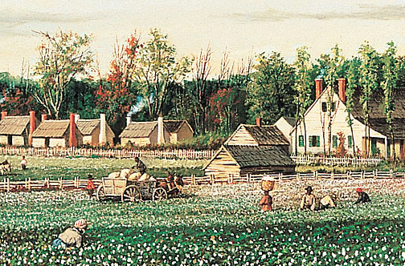
Antebellum Georgia
GPS Standard:
SS8H6 The student will analyze the impact of the Civil War and Reconstruction on Georgia.
SS8E1 The student will give examples of the kinds of goods and services produced in Georgia in different historical periods.

Slide 2
Southern Class Structure
Northern class structure based on wealth and allowed people to move upward
In the South, social structure based on class and being “born into the right family,” making it more difficult to move upward from one group to another
Divided into six groups: planters, farmers with slaves, merchants and “people of letters,” yeoman farmer and poor whites, free blacks, and slaves

Slide 3
Southern Class Structure
Planters were divided into 2 categories – large and small. By 1860, planters, who made up 1% of the population, were the wealthiest people in the United States.
Farmers who owned less than 20 slaves made up the small middle class. The head of the household was directly involved in running the farm.
Merchants and “people of letters” included cotton brokers, merchants, teachers, doctors, ministers, newspaper publishers, and lawyers.
Yeoman farmers were by far the largest group of white southerners. They were independent farmers who scrambled just to make a living. Poor whites were considered the poorest yeoman farmers.
Free blacks were mostly concentrated in the Upper South. Some free black owned slaves and small plantations. Although they were “free,” they were denied most citizenship rights.
Slaves made up about 4 million of the total black population in the 1860s. By 1860, 11.5% of slaves lived in Georgia.

Slide 5
Southern Social Ladder
Wealthiest to Poorest

Slide 6
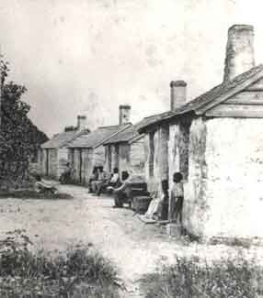
Hard Work Simple Living
Slaves worked long hours in swampy, flooded fields or in the cotton, tobacco, or rice fields six days a week
Work began at sun up and continued until sundown; the owner or overseer punished slaves who did not harvest enough
Drivers, older slaves trusted by the plantation owner, also supervised the field hands
Slave children, as young as five, also worked hard on the plantations and farms
Slave huts were small, very simply furnished, and crudely built; foods were basic

Slide 7
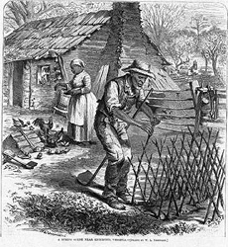
Slave Family Life
Slave families sometimes became separated
Owners encouraged slave marriage; slave children became property of the woman slave’s owner
Religion was important; black preachers spoke of freedom and justice
Spiritual songs encouraged slaves throughout their lives
Education was nearly nonexistent, although minimal reading and writing skills were permitted by some slave owners

Slide 8
Slave Rebellions
1831 - Nat Turner led bloody rebellion in Virginia; between 57 and 85 people died; Turner was hanged
Nat Turner’s Rebellion and other unsuccessful insurrections prompted strict laws across the South designed to curtail slave movements, meetings, and efforts to learn to read and write
These laws applied to both slaves and freed blacks

Slide 10
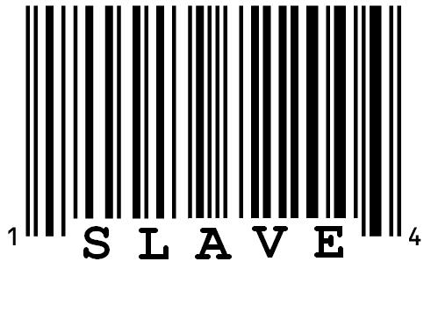
Slave Codes
Took away nearly all rights of slaves
Slaves could not carry weapons, make any contact with white people
People who tried to help people of color were abolitionists; slaves could not work any job involving reading and writing
Slaves had little time to talk together

Slide 11
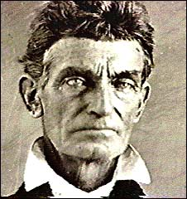
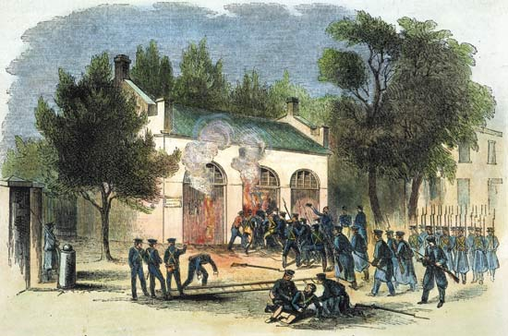
John Brown
White abolitionist John Brown led a raid on federal arsenal (arms storehouse) at Harper’s Ferry, Virginia
Brown wanted ammunition to lead a rebellion to free the South’s slaves
He was captured and hanged for treason
The John Brown Raid added to fear and distrust, especially in the South; to many Northerners, Brown became a hero

Slide 12
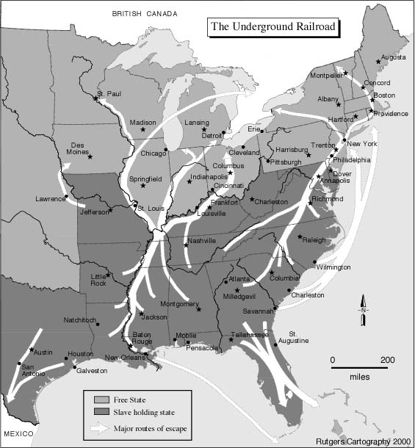
The Underground Railroad
Network of roads, houses, river crossings, boats, wagons, woods, and streams operated by blacks and whites
Provided a trail of flight for slaves seeking freedom in Canada or the Northern states
Safe stops along the way called stations
Ex-slave Harriet Tubman personally helped more than 300 slaves escape to freedom

Slide 13
Slavery Mini-Review
John Brown | Harriet Tubman | Nat Turner | Drivers | Abolitionists
____________________ | Led a bloody rebellion in Virginia in 1831
____________________ | People who wanted to help slaves
____________________ | Older slaves trusted by plantation owners
____________________ | Raided a federal arsenal to get weapons to frees the South’s slaves
____________________ | Led 300 slaves to freedom through the Underground Railroad

Slide 14
Georgia’s Pre-War Economy
68,000 farms by 1860; cotton was chief crop
500 plantations (500 acres or more); most farms were less than 100 acres
60 percent of Georgians owned no slaves; only 236 had 100 or more slaves
Half of Georgia’s total wealth was in slaves ($400 million)
1,890 factories in Georgia by 1860; about $11 million in value

Slide 15
Tariffs
Tariffs, or taxes on imported goods, were another source of conflict between North and South
Northern states wanted higher tariffs because items made in the North would cost less than imported ones
Southern states had fewer factories and bought many manufactured goods from foreign countries. Therefore, they did not want higher tariffs.

Slide 16
Education
Most Georgians had little education
20 percent of Georgians were illiterate in 1850
$100,000 allotted in 1858 to begin free schools; the outbreak of the Civil War delayed these plans
Georgia’s first law school founded in 1859
Blacks were not given educational opportunities

Slide 17
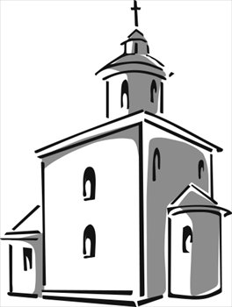
Religion
Georgians involved in the Great Revival Movement of the early 1800s
Religious revivals were popular, especially among Methodists
By 1860, Georgia second only to Virginia in the South in number of churches
Methodists and Baptists most common religions

Slide 18
States’ Rights
States’ rights: the belief that the state’s interests should take precedence over the interests of the national government
Clearest difference between North and South
North | South
believed that political decisions should be made that would benefit the entire country All states should abide by laws made by Congress, signed by the President, or decreed by the courts | Thought states had the right to govern themselves and decide what would be best for their own needs and situation Politicians from the North could not possibly understand or care about Southern states

Slide 19
Doctrine of Nullification
Southerners understood the 10th Amendment to mean that they could ignore federal laws which they believed violated the Constitution
This belief is known as the doctrine of nullification: claimed that state authority could “nullify” (cancel) national laws
In 1832, South Carolina nullified a federal tariff or tax on British imported goods because they felt it was unfair to Southern consumers; S.C. threatened to secede, causing the U.S. government to back off and lower the tariff

Slide 20
Missouri Compromise
In 1820, Missouri was set to become a new slave state.
Congress had to keep a balance between the number of free and slave states.
Maine would enter Union as a free state, Missouri admitted as a slave state
Slavery was banned north of latitude 36°30’

Slide 21
The United States after the Missouri Compromise

Slide 22
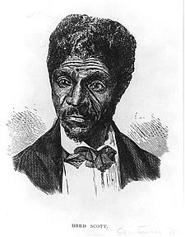
Dred Scott Decision
In 1834, Dred Scott, a slave, was taken by his owner from the slave state of Missouri to the free state of Illinois and later to Wisconsin, also a free state
Upon return to Missouri, Scott filed a lawsuit claiming he was free since he had lived in a free state
Brought to the U.S. Supreme Court in 1857
Said Scott could not sue because he was a slave, and slaves were not citizens
Court also ruled that Congress had no right to stop slavery in territories

Slide 23
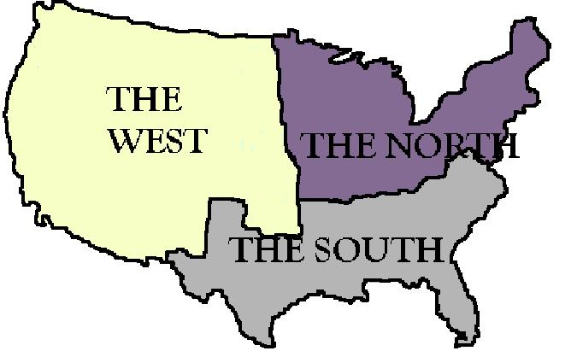
Sectionalism
Sectionalism: the belief by the people in a given region or area that their ideas and interests are better and more important than those of another regions or area
As the country moved westward, the issue of slavery would have to sorted out

Slide 24
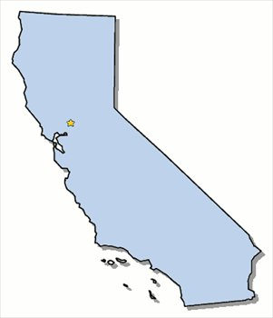
Compromise of 1850
By 1849, California’s population had reached over 100,000, enough to ask for statehood. Yet, California’s constitution prohibited slavery. If California were to join the Union as a free state, there would no longer be a balance of free and slave states.
For eight months, Congress tried to agree on what to do about California. This was later called “The Great Debate.”
California would enter Union as a free state

Slide 25
Compromise of 1850
New Mexico territory would not become part of Texas or a guaranteed slave state
The District of Columbia would no longer trade slaves, but slave owners there could keep their slaves
Runaway slaves could be returned to their owners in slave states
Utah and New Mexico territories could decide if they wanted to allow slaves or not
Fugitive Slave Act: stated that slaves who ran away to free states would be returned to their owners

Slide 26
U.S. after Compromise of 1850

Slide 27
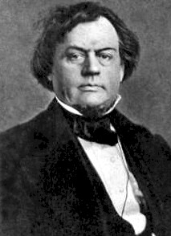
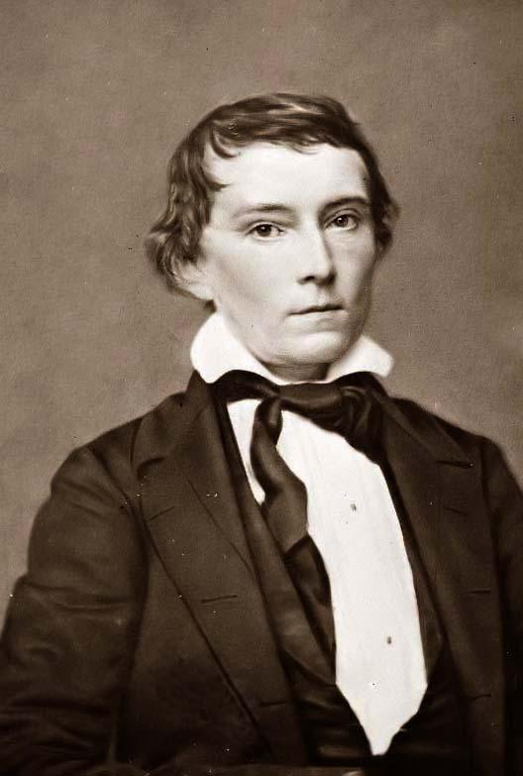
Georgia Platform
Robert Toombs
Two Georgia congressmen who played key roles in securing support for the Compromise of 1850 among southerners were Robert Toombs and Alexander Stephens
Georgia called a special convention to vote on whether to accept the compromise and remain in the Union or not
The Georgia Platform stated that the state accepted the Compromise of 1850, but it would not hesitate to resist any effort by Congress to outlaw slavery in new territories
Alexander Stephens

Slide 28
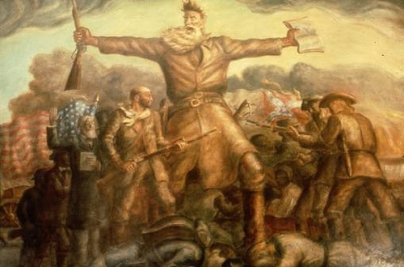
Kansas-Nebraska Act
Created the territories of Kansas and Nebraska
Those territories had right of popular sovereignty
Popular Sovereignty: When a territory asked for statehood, the people could vote on whether they wanted to be a free state or slave state
Northerners were angry because this changed the Missouri Compromise
New territories had two groups of people: proslavery or free soil
Free soilers were against slavery and also wanted land to be given to western settlers for farming
Bloody fights broke out between proslavery and free soilers

Slide 30
In the Missouri Compromise, which state entered the Union as free?
What is popular sovereignty?
How did the South benefit from the Compromise of 1850?

Slide 31
Antebellum Georgia Politics
Democrats and Whigs were two major political parties
Democrats supported states’ rights; took strong stand for slavery
Whigs mainly from upper social classes; favored moderate protective tariff and federal help for the South
Most governors were Whigs; most legislators were Democrats

Slide 32
Know-Nothing Party
Leading Georgians formed two new political parties; one party favored the Compromise of 1850 while the other did not
A secret party, the Know-Nothing party, did not want immigrants to become citizens or anyone not born in the United States to hold political office
Members answered all questions, “I don’t know”
By 1856, Democrats were dominant party; Dem. Joseph E. Brown, elected governor in 1856, served during the Civil War

Slide 33
The Republican Party
Republican Party formed in 1854 in free states
Antislavery Whigs and Democrats joined
Nominated Abraham Lincoln of Illinois as their candidate in 1860
Southern and Northern Democrats split over slavery issues and nominated separate candidates
Southerners angrily viewed the plans of the Republicans as non-beneficial to the South

Slide 34
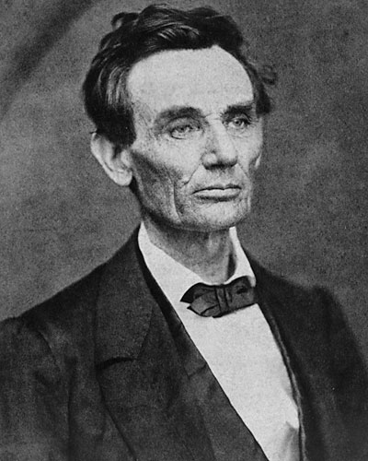
Georgia and Lincoln’s Election
Georgians were, for the most part, for the Union; however, they were strongly for states’ rights
Despite lawmakers’ strong debates for and against secession, a Secession convention began in January 1861 in Milledgeville, the capital
A secession ordinance (bill) passed 208-89
The Southern states who seceded met in Montgomery, Alabama in February, 1861; they formed the Confederate States of America. Robert Toombs named Secretary of State of the Confederate States of American (CSA)
Alexander H. Stephens named Vice-President
Governor Joseph E. Brown favored secession and used his terms as governor to prepare Georgia for war

Slide 35
Give Me Five
Draw an outline of your hand and give me 5 reasons why Georgia seceded from the Union….

